Slide 1
AI Meme & Poster Creator
CAPSTONE PROJECT
Presented by: C. Susheel Kumar Department: Electronics and Communication Engineering Institution: SRM Institute of Science and Technology (Kattankulathur Campus)

Slide 2
OUTLINE
Problem Statement
System Development Approach
Algorithm & Deployment
Results
Conclusion
Future Scope
References

Slide 3
Problem Statement
Creative Bottleneck: Students and content creators struggle to generate memes and posters quickly during events, campaigns, or academic projects. Time constraints often hinder quality output.
Tool Complexity: Existing design tools like Photoshop or Canva have steep learning curves. API-dependent solutions face rate limits, internet dependency, and subscription costs.
The Solution Gap: There's a critical need for a simple, offline, AI-powered tool offering full customization, instant preview, and integrated gallery management—all without external dependencies.

Slide 4
System Approach
Layer | Technologies / Features
Frontend | - Gradio: Builds the interactive web UI with tabs for testing, creation, and gallery<br>- User inputs for image upload/URL, text overlay, font settings, preview
Backend | - Python: Core logic, routing, and API integration<br>- Base44 API: Handles cloud sync, save/load operations<br>- JSON Templates: Define flexible meme/poster layouts
Model Engine | - AI-driven overlay logic: Applies text to images based on user input<br>- Pillow (PIL): Renders text, adjusts font, color, position<br>- Optional: Extendable for future AI captioning
Data Handling | - Requests: Communicates with Base44 API<br>- NumPy: Assists with image array manipulation and processing<br>- Local Gallery: Stores and manages saved creations offline

Slide 5
Algorithm & Deployment
1️⃣ Fetch / Upload : Users begin by selecting an image either from their local device or by pasting a valid image URL. The system validates the input and prepares it for processing.
2️⃣ Text Overlay: Users enter custom text (top/bottom or multi-line) and configure: Font style, size, and color Text alignment and positioning . The app uses Pillow (PIL) to render the text directly onto the image canvas.
3️⃣ Preview: A live preview is generated using Gradio, allowing users to: View the meme/poster before saving and Make real-time adjustments to text and layout.
4️⃣ Save & Sync: Finalized creations are saved locally in a structured gallery folder. Simultaneously, the app sends a POST request to the Base44 API to sync the creation to the cloud.
5️⃣ Gallery Management: Saved images are displayed in the Gallery Tab with options to:View, edit, or delete and Reopen for further customization . Metadata and API sync status are shown for each item.

Slide 6
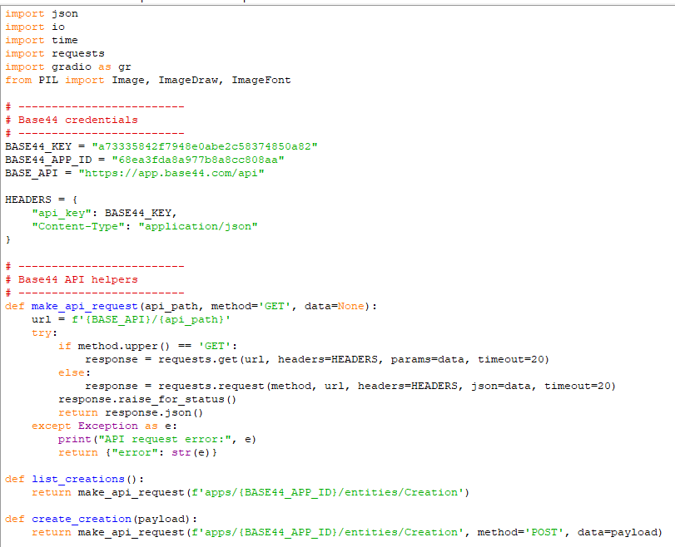
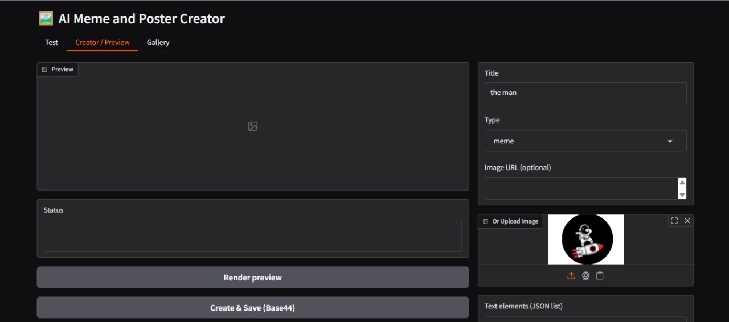
Result

Slide 7
GITHUB AND DEPLOYMNET LINK
Github Link : coding files GITHUB :https://github.com/csusheel371-dotcom/meme-and-poster
Deployment link: http://127.0.0.1:7860/

Slide 8
Project Impact & Conclusion
Time Efficiency: Dramatically reduces meme and poster creation time from hours to minutes, enabling students to focus on content quality rather than technical complexity.
Creative Empowerment: Removes technical barriers, allowing users to express creativity freely. The intuitive interface encourages experimentation and artistic exploration.
User-Friendly Design: Zero learning curve with instant previews and simple controls. Perfect for students, event organizers, and content creators at all skill levels..

Slide 9
Future Scope & Enhancements:
AI Caption Generator: Implement text-to-meme functionality where AI automatically generates witty captions based on image content analysis, reducing creation time even further.
Template Library :Build a comprehensive collection of pre-designed templates for festivals, academic events, campaigns, and trending meme formats with one-click customization.
Cloud Deployment: Migrate to cloud infrastructure for public accessibility, enabling users to create and share content from anywhere without local installation.
Multilingual Support: Add support for multiple Indian and international languages, including Hindi, Tamil, Telugu, and others, making memes more inclusive and culturally relevant.

Slide 10
References
1.Gradio Documentation : https://www.gradio.app/docs
Base44 API Docs :https://docs.base44.com
Pillow (PIL) Image Library :https://pillow.readthedocs.io/en/stable/
OpenAI Image & Vision Guide :https://platform.openai.com/docs/guides/images-vision

Slide 11
THANK YOU

